Slide 1
Software Engineering
Lecture-4

Slide 2
RAD (Rapid Application Development) Model
Extremely short development life cycle
“High-speed” adaptation of Waterfall
Component based construction
If requirements are well-understood, fully functional system can be built in limited time.
Concurrent process of specification, design and implementation.

Slide 3
RAD Model
Multiple software teams work in parallel on different system functions.
Reusable software components can be constructed.
Results in a significantly short development time.

Slide 4
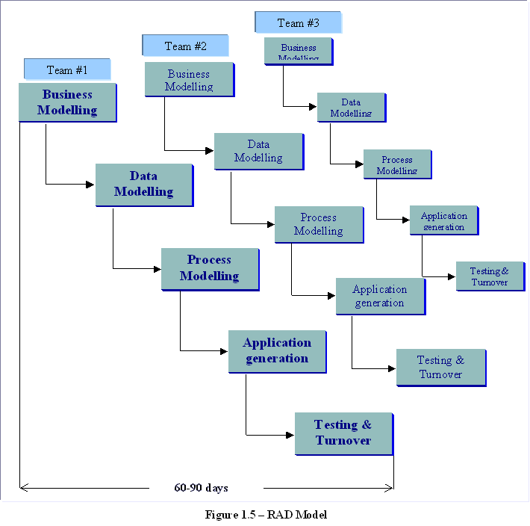
RAD Teams

Slide 5
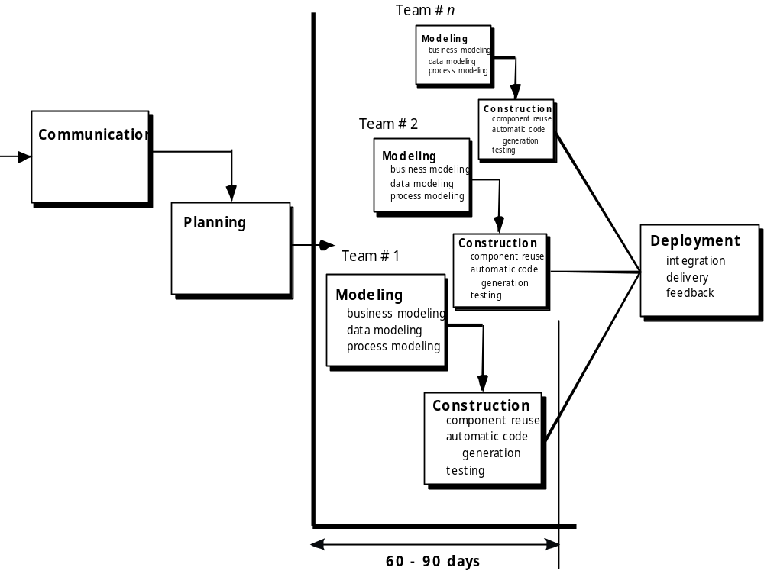

Slide 6
When to use RAD?
  For modular systems:
    Each module can be completed in less than 3 months
  Each module can be addressed by a separate RAD team and then integrated to form a whole.

Slide 7
RAD Model
Business Modelling
  Information flow among business functions is modelled
  What info generated? Who generates? Where does info go? Who processes it?
Data modelling
  Refinement of information flow
  Defining attributes and relationships of data objects
Process modelling
  Transformation of data objects to implementation
  Processing descriptions for CRUD of data objects
Application generation
  Software construction, creation of reusable components
Testing and turnover
  Testing of components and interfaces

Slide 8
Drawbacks
More Human resources required for right number of RAD teams
Developers and customers are required to complete the system in minimum time
If developers and customers are not committed to the rapid-fire activities, the project would fail
If the system cannot modularized properly, it can be problematic.
Not applicable when high risks are involved

Slide 9
Variations of Iterative Development
Evolutionary models
  Software evolves
  Requirements change
  Develop more complete versions of software
  Examples: Prototyping, Spiral, etc.

Slide 10
Iterative vs. Incremental
In principle:
incremental development:
  Build software piece-by-piece by adding new pieces only.
iterative development:
  Build software by producing many small releases.
  Focus on adding functions, but also change existing functions as necessary.

Slide 11
Iterative vs. Incremental
In practice:
Purely incremental development is rarely possible.
Most people use the terms interchangeably.

Slide 12
Spiral Model
Combination of iterative nature of Prototyping and controlled aspects of Waterfall.
Provides the potential for rapid development of incremental versions of software
It is a cyclic approach for incrementally growing a system’s degree of definition and implementation while decreasing its degree of risk.
Software is developed in a series of evolutionary releases.
In early iterations, release might be paper model or prototype.
During later iterations, increasingly more complete versions are produced.

Slide 13
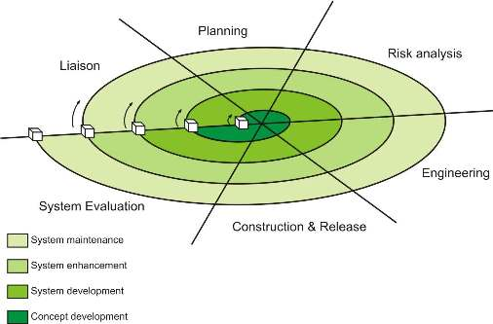

Slide 14
Spiral Model
Each loop in the spiral shows a phase of the SW process.
Each loop will be split into few sections, the task regions.
Each region conducts a set of work tasks, the task set.

Slide 15
Loops
The loops in the spiral could be identified as:
concept development, product development, product enhancement and product maintenance OR
product specification, prototype development, software versions updated OR
system feasibility, requirements definition, system design, etc.
Beginning at the center of the spiral and moves around in a clockwise direction

Slide 16
Task Regions
The task regions in each spiral loop could contain:
customer communication, planning, risk analysis, engineering, construction & release, customer evaluation OR
objective setting, risk assessment and reduction, development and validation, planning
Points: when to trigger a new phase of the spiral and what to do?

Slide 17
Assessment of both management and technical risks is performed as each incremental release is completed
Ideally, it is a realistic approach to a large-scale system development and it may include other process models
It demands risk assessment expertise and relies on this expertise for success.

Slide 19
Framework Activities
Spiral model is divided into a number of framework activities called task regions
  Customer communication / Liaison
  Planning
    to define resources, timelines, etc
  Risk analysis
    To assess technical, management risks
  Engineering
    To build various representations of the application
  Construction and release
    To construct, test, install and document
  Customer evaluation
    To obtain user feedback

Slide 20
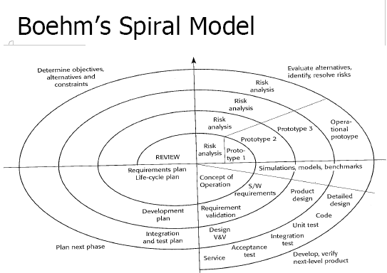

Slide 21
Spiral Model
Team moves in clockwise direction beginning at the centre
1st cycle - product specification
Subsequent cycles - prototype and then refined versions
Each pass through planning results in adjustments to project plan, cost and schedule adjustments based on customer feedback
A realistic approach for the development of large scale applications
Developer and customer better understand and react to risks at each evolutionary level, uses prototyping as a risk reduction mechanism.

Slide 22
Spiral Model
A software project repeatedly passes through these phases in iterations (called Spirals in this model).
The baseline spiral, starting in the planning phase, requirements are gathered and risk is assessed.
Each subsequent spiral builds on the baseline spiral.
Requirements are gathered during the planning phase.
In the risk analysis phase, a process is undertaken to identify risk and alternate solutions.
  A prototype is produced at the end of the risk analysis phase.
Software is produced in the engineering phase, along with testing at the end of the phase.
The evaluation phase allows the customer to evaluate the output of the project before the project continues to the next spiral.

Slide 23
Benefits
High amount of risk analysis
Good for large and mission-critical projects.
Software is produced early in the software life cycle.

Slide 24
Drawbacks
Can be a costly model to use.
Risk analysis requires highly specific expertise.
Project’s success is highly dependent on the risk analysis phase.
Doesn’t work well for smaller projects.

Slide 25
Working Area Model
Divide software process into working areas (logically related activities) rather than phases (time intervals)
Defines only the activities to be executed and their logical relationships, but not their temporal order.

Slide 26
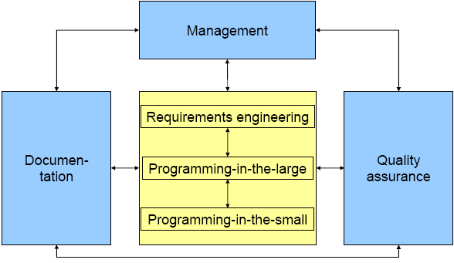
Working Area Model

Slide 27
Working Areas
Requirements engineering:
  definition of the requirements to a software product (both functional and nonfunctional)
Programming-in-the-large:
  design of the architecture of a software product in terms of subsystems, modules, etc.
Programming-in-the-small:
  writing the actual code
Quality assurance:
  verification, test, code reviews, etc.
Documentation:
  informal description of a software product either for users or for system developers
Management:
  coordination of all activities performed in the software process

